Slide 1
Title of Talk
by Name Surname
##th December 2019
IAFIG-RMS - Bioimage Analysis With Python
Cambridge Bioinformatics Training Centre
Introduction to ImageJ
Part I: Basic Image handling
2012
Graeme Ball
TODAYS TALK:
Section Title
Section Title
Section Title
Section Title
Section Title

Slide 2
Section Title

Slide 3
Title of slide (e.g. Conventional Microscopy)
Confocal micrograph
100 μm
10 μm
1 μm
100 nm
10 nm
Wide-field microscope
Confocal microscope
Sympathetic neuron
CFP-gamma7
mouse EEA1, anti-mouse texas red
Main points of the slide.
point one
point two.
Source: Where you credit your sources E.g.: Adapted from http://zeiss-campus.magnet.fsu.edu/articles/superresolution/introduction.html, Sympathetic neuron image (D. Waithe).

Slide 4
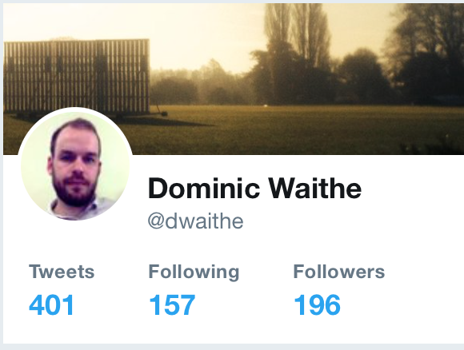

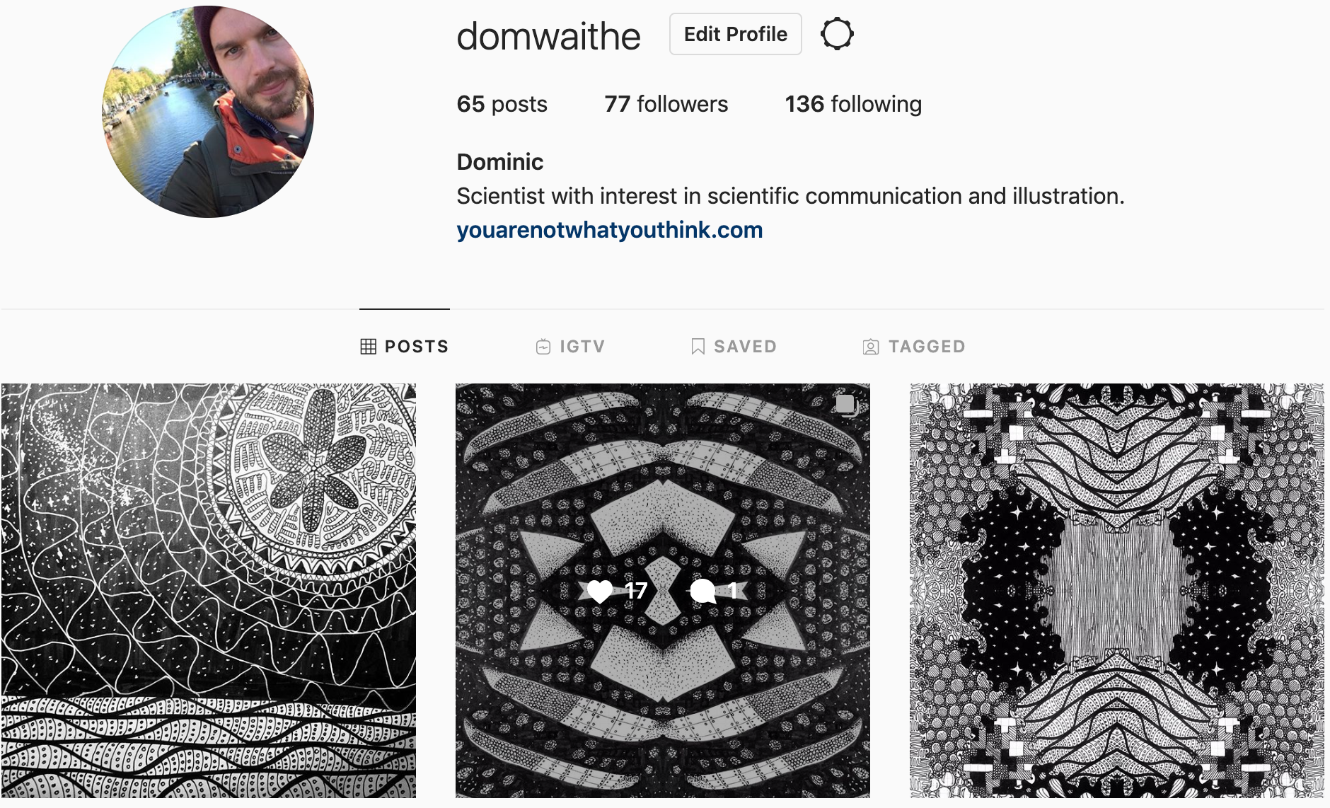


Last slide, a chance to promote your things
For this content and more:
https://github.com/IAFIG-RMS/Bioimage-training
https://twitter.com/dwaithe
https://github.com/dwaithe
https://instagram.com/dwaithe
dominic.waithe@imm.ox.ac.uk

